Slide 1
Accounting Principles
Thirteenth Edition
Weygandt ● Kimmel ● Kieso
Chapter 2
The Recording Process
This slide deck contains animations. Please disable animations if they cause issues with your device.

Slide 2
Chapter Outline
Learning Objectives
L O 1 Describe how accounts, debits, and credits are used to record business transactions.
L O 2 Indicate how a journal is used in the recording process.
L O 3 Explain how a ledger and posting help in the recording process.
L O 4 Prepare a trial balance.

Slide 3
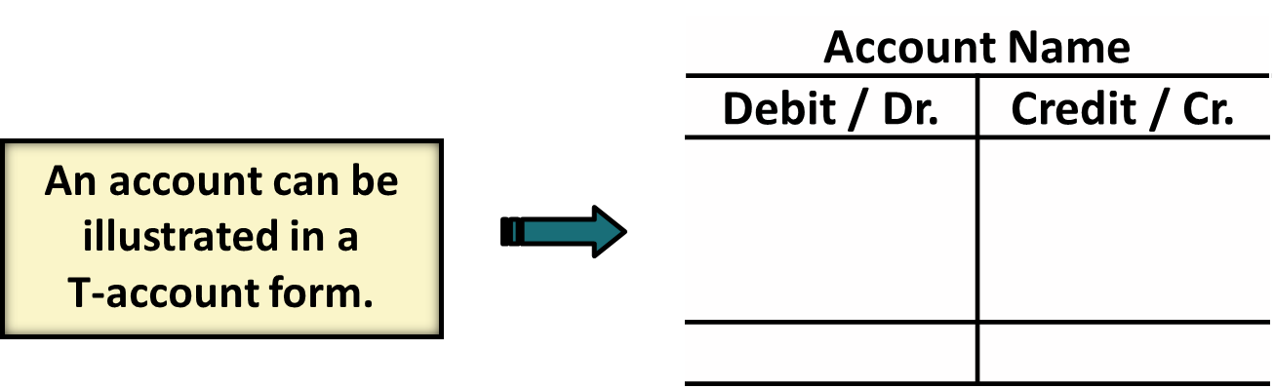
Accounts, Debits, and Credits (1 of 4)
LEARNING OBJECTIVE 1
Describe how accounts, debits, and credits are used to record business transactions.
The Account
Record of increases and decreases in a specific asset, liability, owner’s equity, revenue, or expense item.
Debit = “Left.”
Credit = “Right.”
L O 1

Slide 4
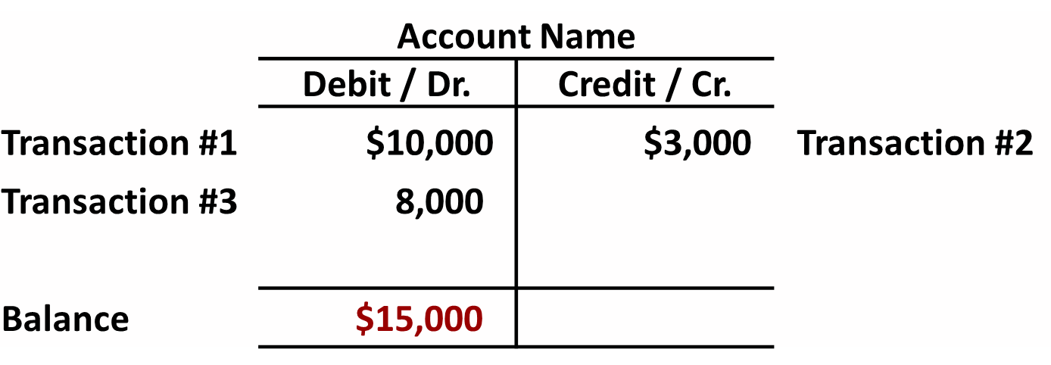
Debits and Credits (1 of 3)
If the sum of Debit entries are greater than the sum of Credit entries, the account will have a debit balance.
L O 1

Slide 5
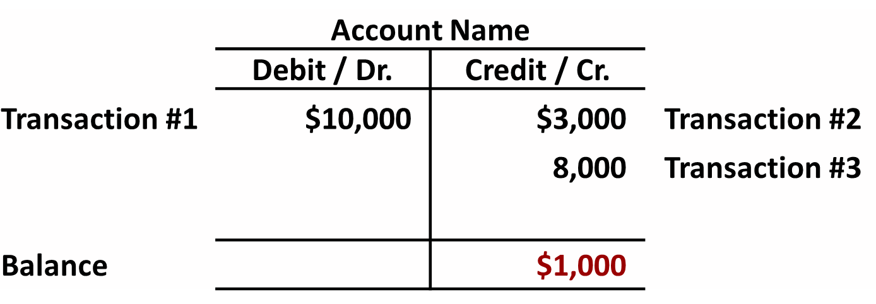
Debits and Credits (2 of 3)
If the sum of Credit entries are greater than the sum of Debit entries, the account will have a credit balance.
L O 1

Slide 6
Debits and Credits (3 of 3)
Debit and Credit Procedure
Double-entry system
Each transaction must affect two or more accounts to keep basic accounting equation in balance
Recording done by debiting at least one account and crediting at least one other account
DEBITS must equal CREDITS
L O 1

Slide 7
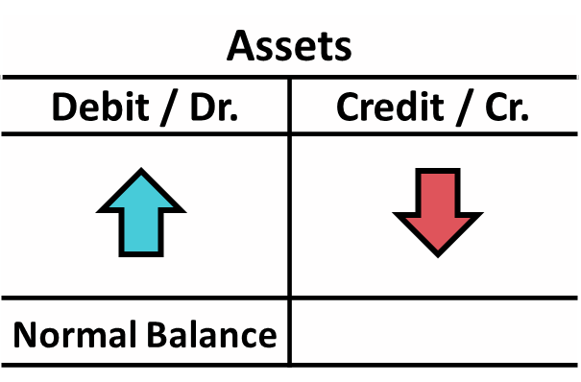
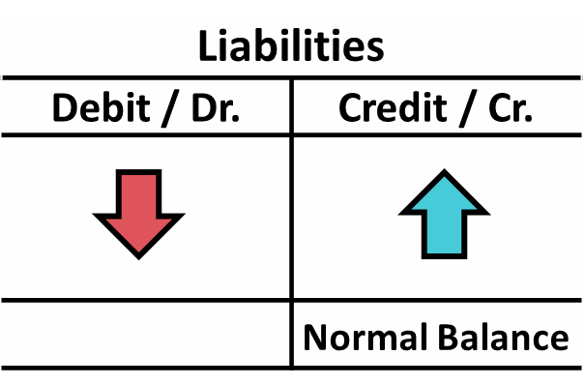
Accounts, Debits, and Credits (2 of 4)
Assets - Debits should exceed credits
Liabilities – Credits should exceed debits
Normal balance is on the increase side
L O 1

Slide 8
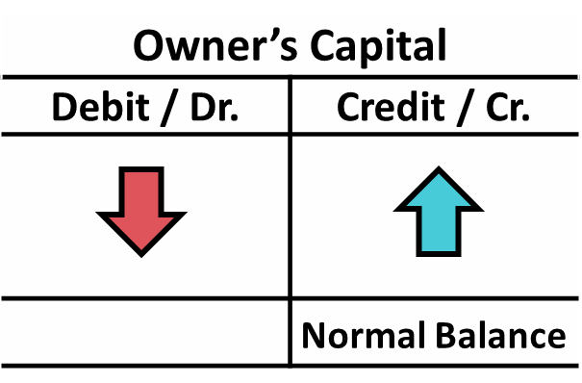
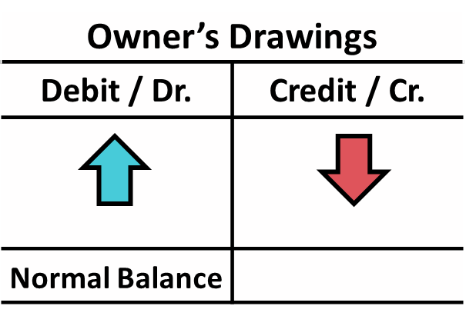
Accounts, Debits, and Credits (3 of 4)
Owner’s investments and revenues increase owner’s equity (credit)
Owner’s drawings and expenses decrease owner’s equity (debit)
L O 1

Slide 9
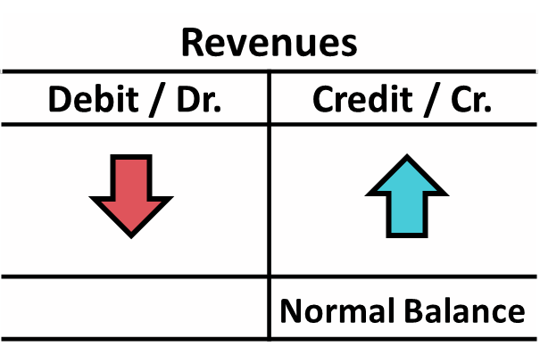
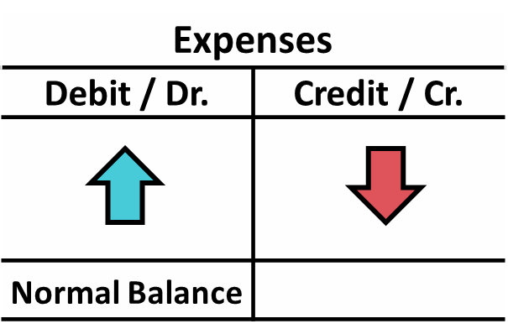
Accounts, Debits, and Credits (4 of 4)
Earning revenues is to benefit owner(s)
Effect of debits and credits on revenue accounts is the same as effect on Owner’s Capital
Expenses have opposite effect
L O 1

Slide 10
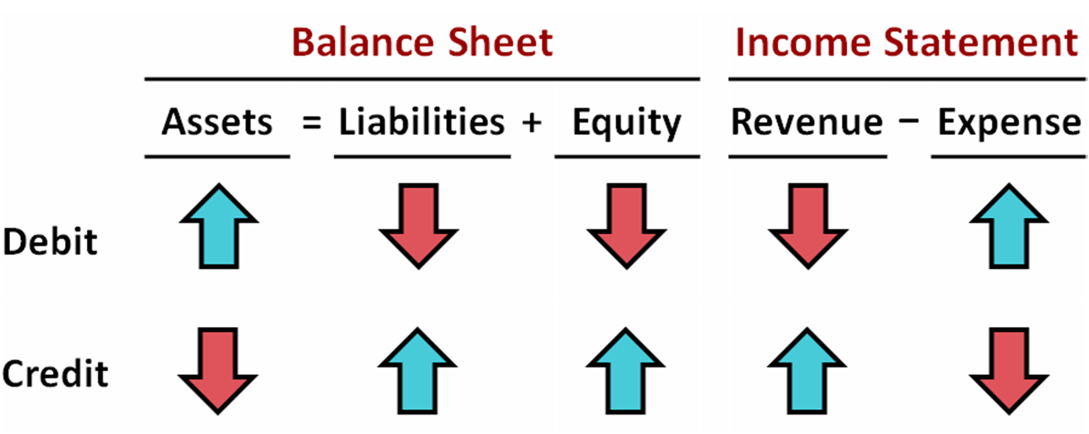
Summary of Debit / Credit Rules (1 of 2)
L O 1

Slide 11
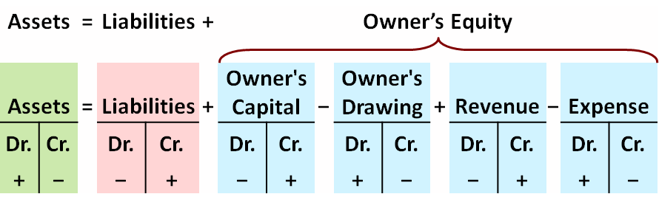
Summary of Debit / Credit Rules (2 of 2)
Debit/credit rules and effects on each type of account.
Equation must be in balance after every transaction. Total Debits must equal total Credits.
L O 1

Slide 12
Debit / Credit Rules (1 of 4)
Debits:
a. increase both assets and liabilities.
b. decrease both assets and liabilities.
c. increase assets and decrease liabilities.
d. decrease assets and increase liabilities.
L O 1

Slide 13
Debit / Credit Rules (2 of 4)
Debits:
a. increase both assets and liabilities.
b. decrease both assets and liabilities.
c. Answer: increase assets and decrease liabilities.
d. decrease assets and increase liabilities.
L O 1

Slide 14
Debit / Credit Rules (3 of 4)
Accounts that normally have debit balances are:
a. assets, expenses, and revenues.
b. assets, expenses, and equity.
c. assets, liabilities, and owner’s drawing.
d. assets, owner’s drawing, and expenses.
L O 1

Slide 15
Debit / Credit Rules (4 of 4)
Accounts that normally have debit balances are:
a. assets, expenses, and revenues.
b. assets, expenses, and equity.
c. assets, liabilities, and owner’s drawing.
d. Answer: assets, owner’s drawing, and expenses.
L O 1

Slide 16
Do It! 1: Normal Account Balance
Kate Browne has just rented space in a shopping mall. She will open a hair salon to be called “Hair It Is.” A friend has advised Kate to set up a double-entry set of accounting records in which to record all of her business transactions. Identify the balance sheet accounts that Kate will likely need to record the transactions needed to open her business. Indicate whether the normal balance of each account is a debit or a credit.
Assets | Liabilities | Equity
L O 1

Slide 17
Do It! 1: Normal Account Balance
Kate Browne has just rented space in a shopping mall. She will open a hair salon to be called “Hair It Is.” A friend has advised Kate to set up a double-entry set of accounting records in which to record all of her business transactions. Identify the balance sheet accounts that Kate will likely need to record the transactions needed to open her business. Indicate whether the normal balance of each account is a debit or a credit.
Assets | Liabilities | Equity
Cash (debit) | Notes payable (credit) | Owner's Capital (credit)
Supplies (debit) | Accounts payable (credit)
Equipment (debit)
L O 1

Slide 18
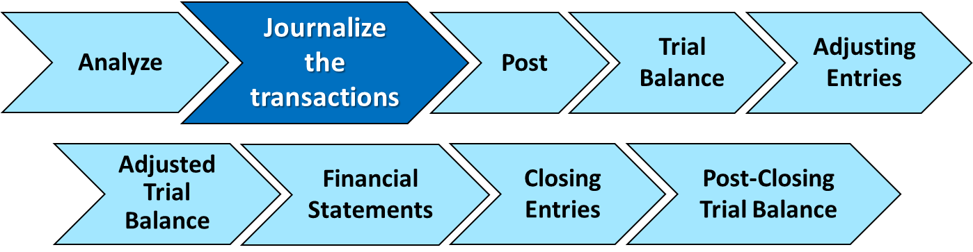
The Journal
LEARNING OBJECTIVE 2
Indicate how a journal is used in the recording process.
The Recording Process
Analyze transaction
Enter transaction in journal
Transfer journal information to ledger accounts
L O 2

Slide 19
The Journal
Book of original entry
Transactions recorded in chronological order
Contributions to the recording process:
Discloses the complete effects of a transaction
Provides a chronological record of transactions
Helps to prevent or locate errors because the debit and credit amounts can be easily compared
L O 2

Slide 20
Journalizing (1 of 2)
Journalizing - Entering transaction data in the journal.
Illustration: On September 1, Ray Neal invested $15,000 cash in the business, and Softbyte purchased computer equipment for $7,000 cash.
 | General Journal |  |  | J1
Date | Account Titles and Explanations | Ref. | Debit | Credit
Sept. 1 | Cash |  | 15,000
 | Owner's Capital |  |  | 15,000
 | Blank
 | Equipment |  | 7,000
 | Cash |  |  | 7,000
L O 2

Slide 21
Journalizing (2 of 2)
Simple and Compound Entries
Illustration: On July 1, Butler Company purchases a delivery truck costing $14,000. It pays $8,000 cash now and agrees to pay the remaining $6,000 on account (to be paid later).
 | General Journal |  |  | J1
Date | Account Titles and Explanations | Ref. | Debit | Credit
July 1 | Equipment |  | 14,000
 | Cash |  |  | 8,000
 | Accounts Payable |  |  | 6,000
 | Blank
L O 2

Slide 22
Do It! 2: Recording Business Activities (1 of 2)
Kate Browne engaged in the following activities in establishing her salon, Hair It Is:
Opened a bank account in the name of Hair It Is and deposited $20,000 of her own money in this account as her initial investment.
Purchased equipment on account (to be paid in 30 days) for a total cost of $4,800.
Interviewed three people for the position of hair stylist.
Prepare the journal entries to record the transactions.
L O 2

Slide 23
Do It! 2: Recording Business Activities (2 of 2)
Prepare the journal entries to record the transactions.
Opened a bank account and deposited $20,000.
Cash
20,000
Owner’s Capital
20,000
Purchased equipment on account (to be paid in 30 days) for a total cost of $4,800.
Equipment
4,800
Accounts Payable
4,800
Interviewed three persons for the position of hair stylist.
No entry
L O 2

Slide 24
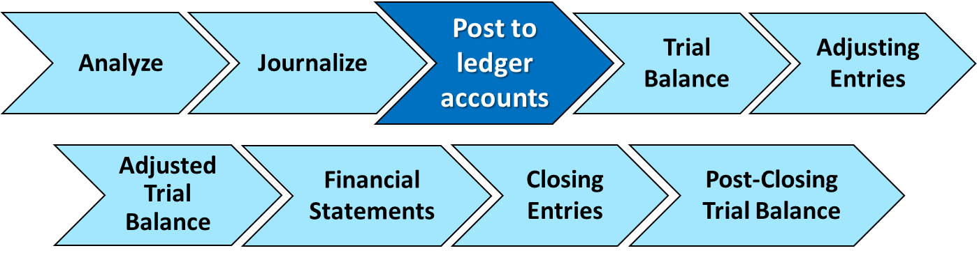
The Journal and Posting
LEARNING OBJECTIVE 3
Explain how a ledger and posting help in the recording process.
The Ledger
Entire group of accounts maintained by a company
Provides the balance in each account
Keeps track of changes in account balances
L O 3

Slide 25
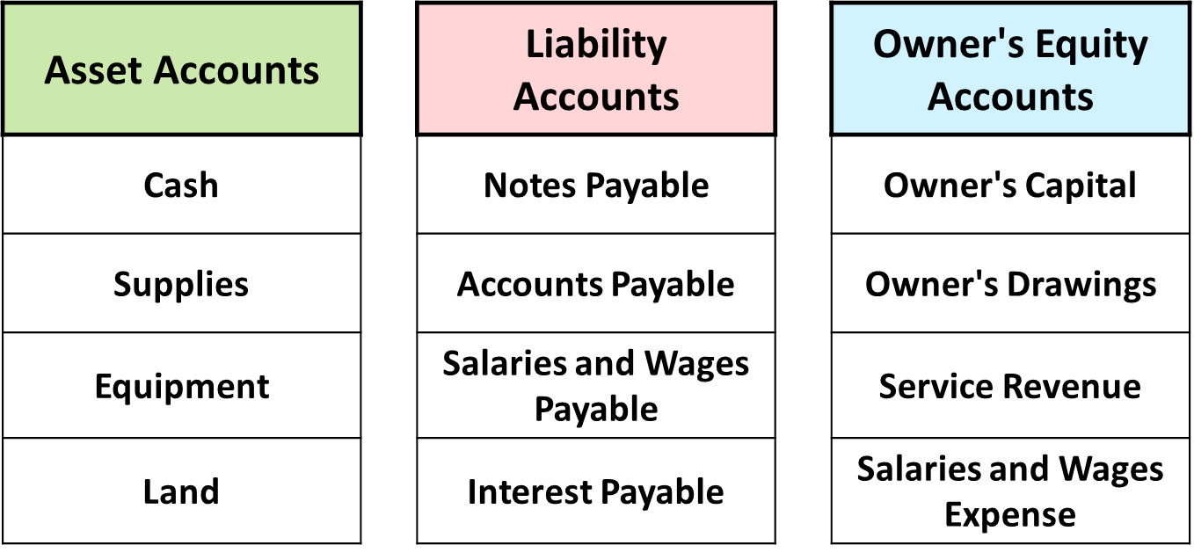
The Ledger (1 of 3)
General ledger contains all asset, liability, and owner’s equity accounts.
L O 3

Slide 26
The Ledger (2 of 3)
Standard Form of Account
 | Cash |  |  |  | NO. 101
Date | Explanation | Ref. | Debit | Credit | Balance
2020 June 1 |  |  | 25,000 |  | 25,000
2 |  |  |  | 8,000 | 17,000
3 |  |  | 4,200 |  | 21,200
9 |  |  | 7,500 |  | 28,700
17 |  |  |  | 11,700 | 17,000
20 |  |  |  | 250 | 16,750
30 |  |  |  | 7,300 | 9,450
L O 3

Slide 27
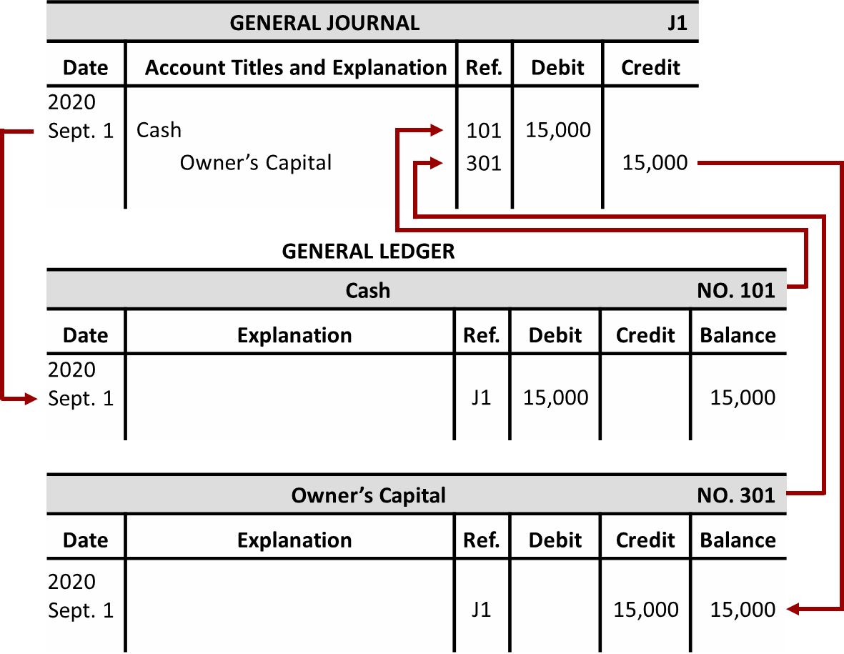
The Ledger (3 of 3)
L O 3

Slide 28
Posting (1 of 2)
Posting:
a. normally occurs before journalizing.
b. transfers ledger transaction data to the journal.
c. is an optional step in the recording process.
d. transfers journal entries to ledger accounts.
L O 3

Slide 29
Posting (2 of 2)
Posting:
a. normally occurs before journalizing.
b. transfers ledger transaction data to the journal.
c. is an optional step in the recording process.
d. Answer: transfers journal entries to ledger accounts.
L O 3

Slide 30
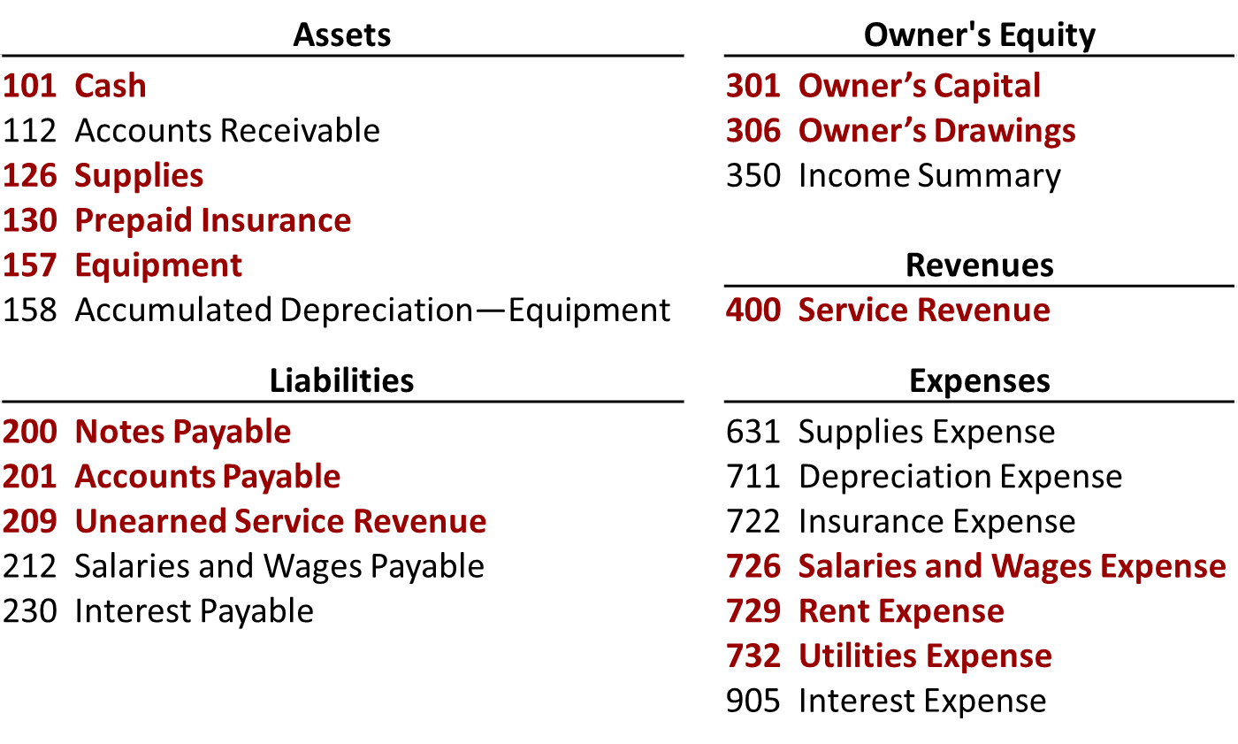
Chart of Accounts
Accounts in Red are used in this chapter.
L O 3

Slide 31
The Recording Process Illustrated (1 of 11)
Follow these steps:
Determine what type of account is involved.
Determine what items increased or decreased and by how much.
Translate the increases and decreases into debits and credits.
L O 3

Slide 32
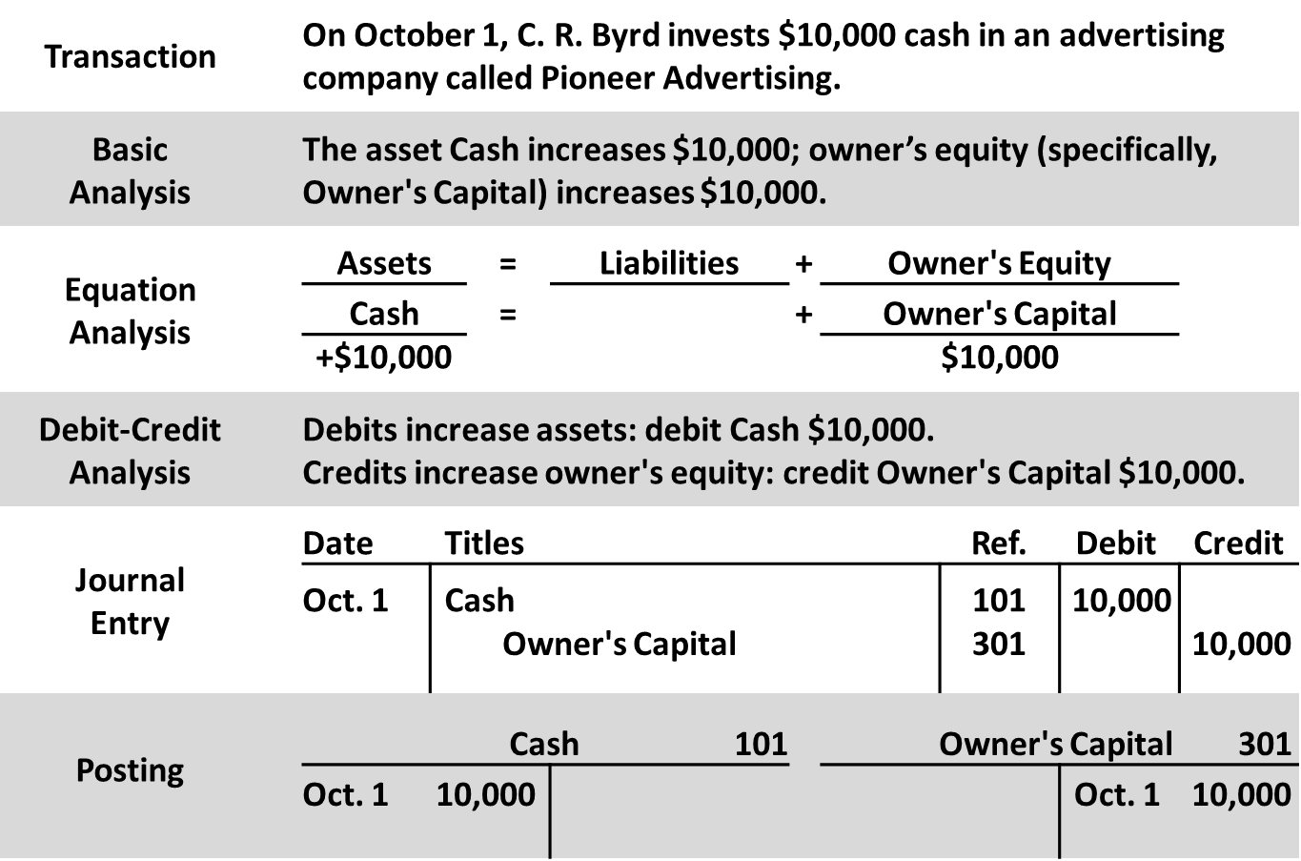
The Recording Process Illustrated (2 of 11)
L O 3

Slide 33
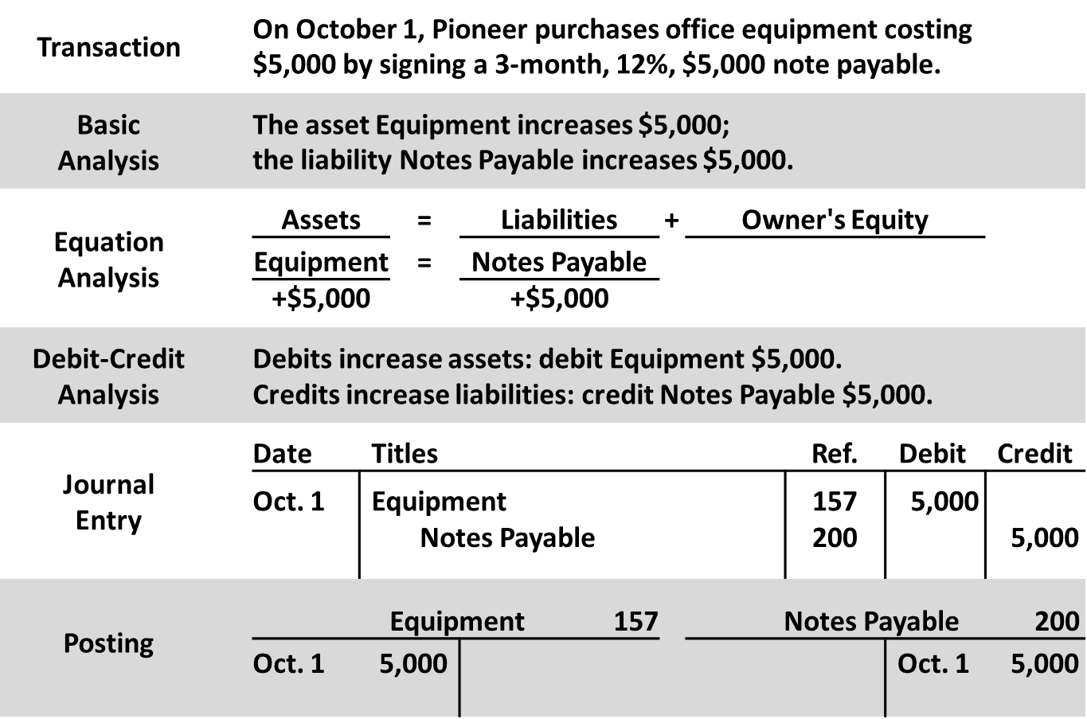
The Recording Process Illustrated (3 of 11)
L O 3

Slide 34
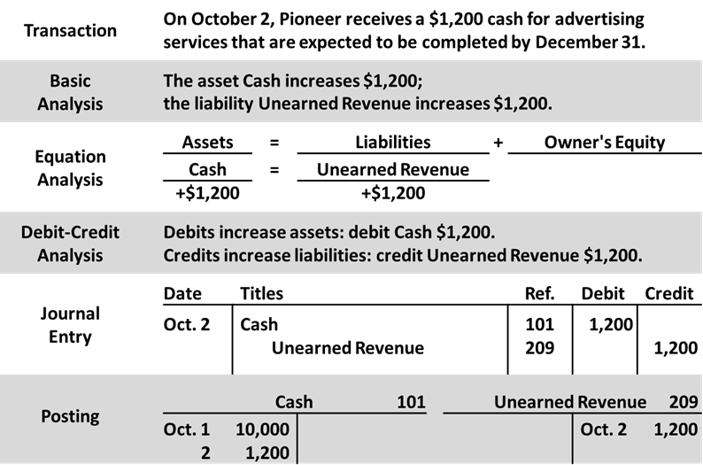
The Recording Process Illustrated (4 of 11)
L O 3

Slide 35
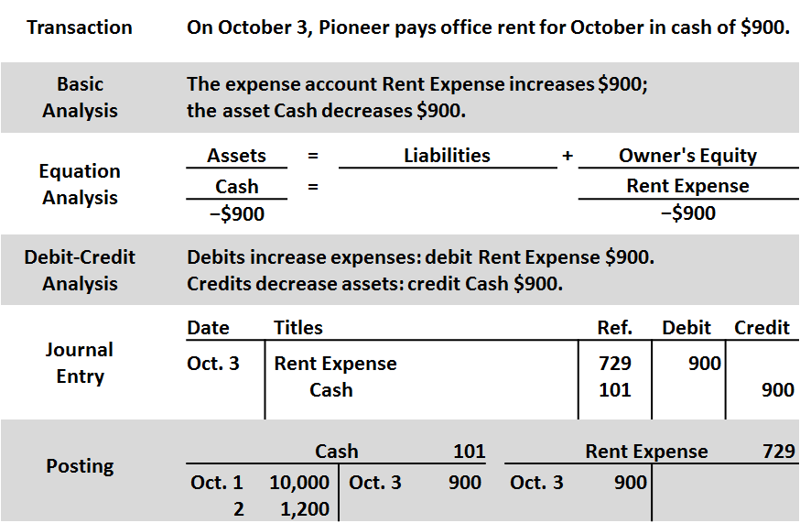
The Recording Process Illustrated (5 of 11)
L O 3

Slide 36
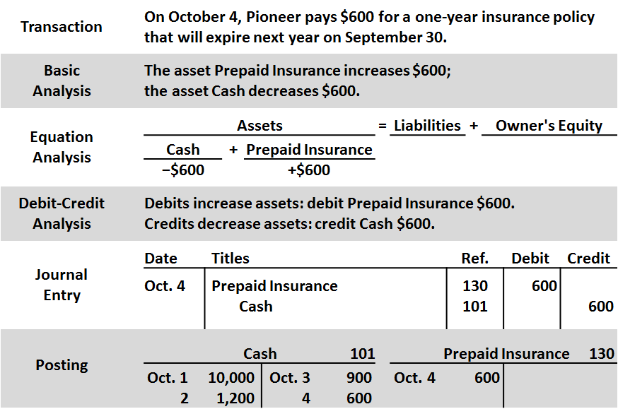
The Recording Process Illustrated (6 of 11)
L O 3

Slide 37
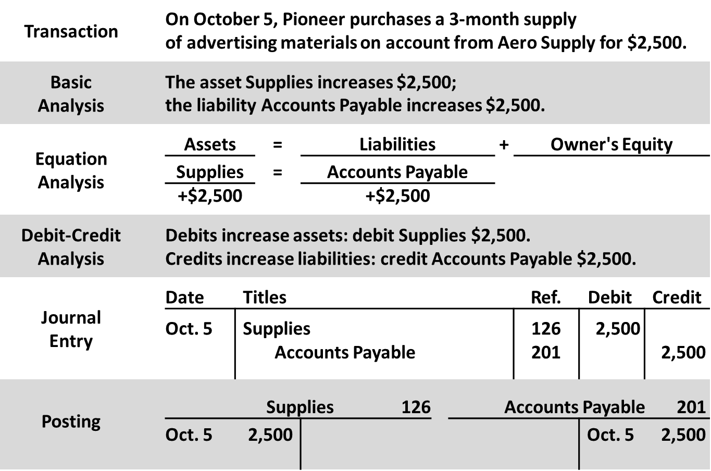
The Recording Process Illustrated (7 of 11)
L O 3

Slide 38
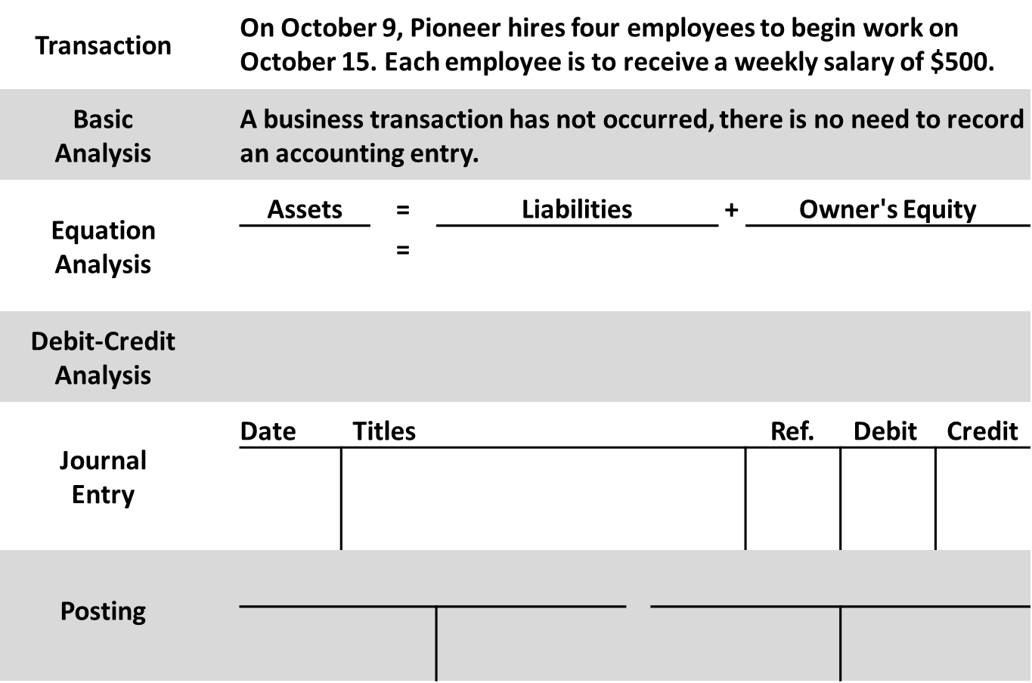
The Recording Process Illustrated (8 of 11)
L O 3

Slide 39
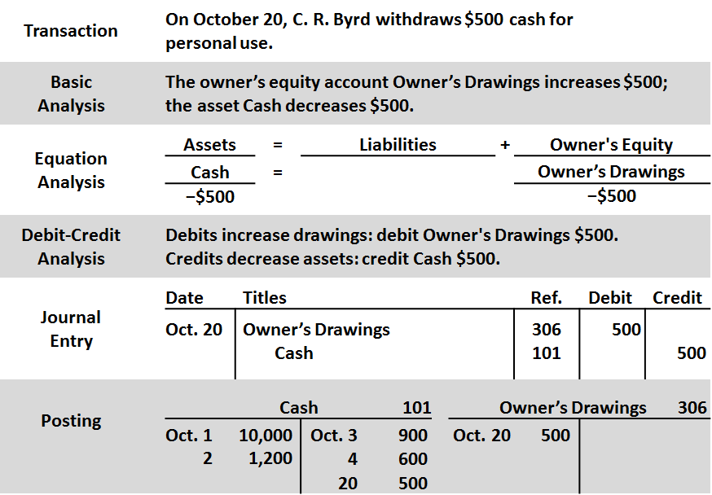
The Recording Process Illustrated (9 of 11)
L O 3

Slide 40
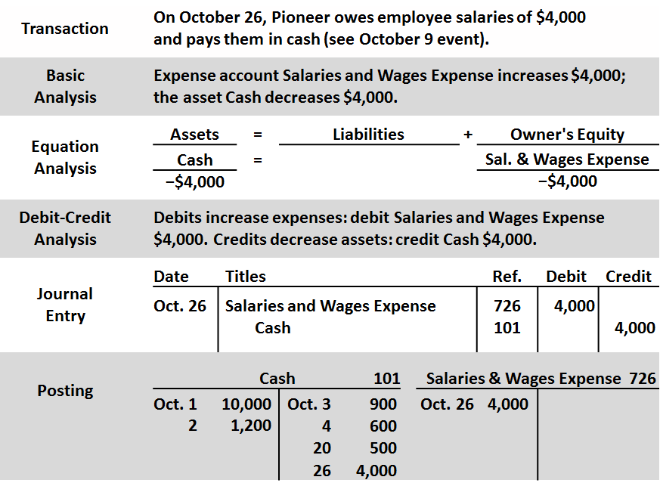
The Recording Process Illustrated (10 of 11)
L O 3

Slide 41
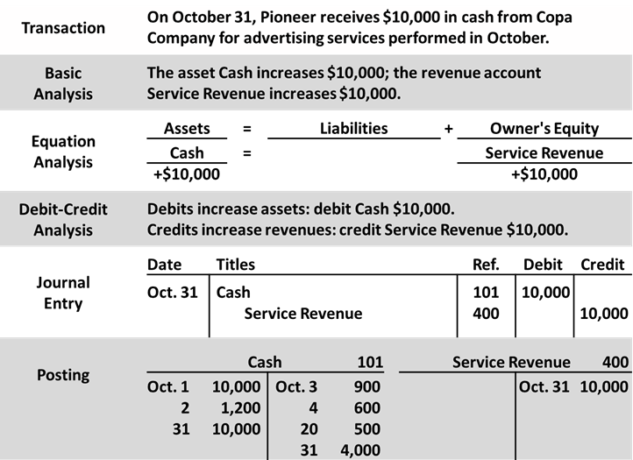
The Recording Process Illustrated (11 of 11)
L O 3

Slide 42
Journalizing and Posting Summary (1 of 3)
 | General journal |  |  | Page J1
Date | Explanation | Ref. | Debit | Credit
2020 Oct. 1 | Cash | 101 | 10,000
 | Owners’ Capital | 301 |  | 10,000
1 | Equipment | 157 | 5,000
 | Notes Payable | 200 |  | 5,000
2 | Cash | 101 | 1,200
 | Unearned Revenue | 209 |  | 1,200
3 | Rent Expense | 729 | 900
 | Cash | 101 |  | 900
L O 3

Slide 43
Journalizing and Posting Summary (2 of 3)
 | General journal |  |  | Page J1
Date | Explanation | Ref. | Debit | Credit
2020 Oct. 4 | Prepaid Insurance | 130 | 600
 | Cash | 101 |  | 600
5 | Supplies | 126 | 2,500
 | Accounts Payable | 201 |  | 2,500
20 | Owner’s Drawings | 306 | 500
 | Cash | 101 |  | 500
26 | Salaries and Wages Expense | 726 | 4,000
 | Cash | 101 |  | 4,000
31 | Cash | 101 | 10,000
 | Service Revenue | 400 |  | 10,000
L O 3

Slide 44
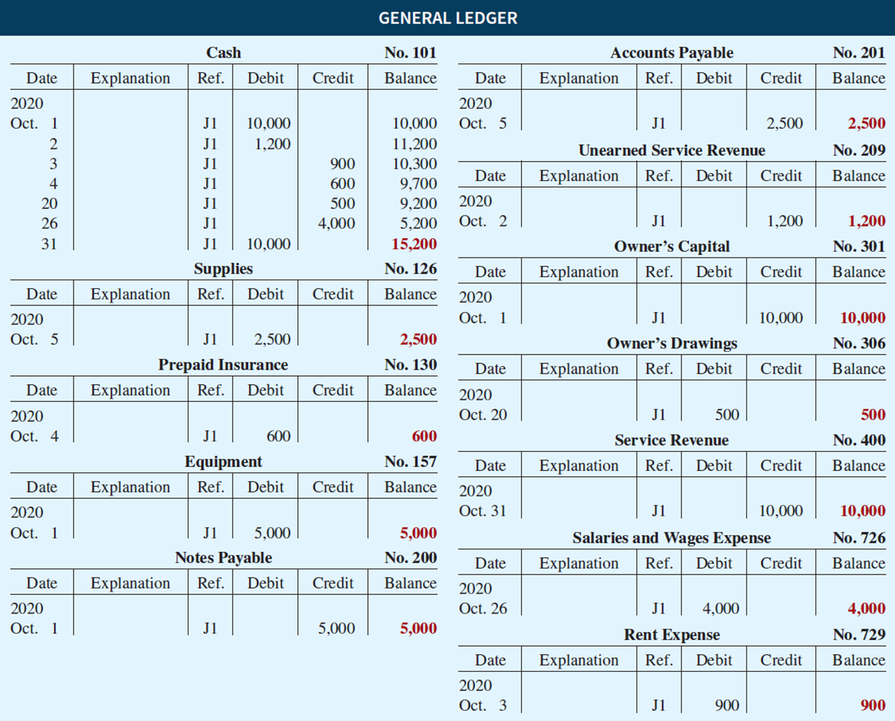
Journalizing and Posting Summary (3 of 3)
L O 3

Slide 45
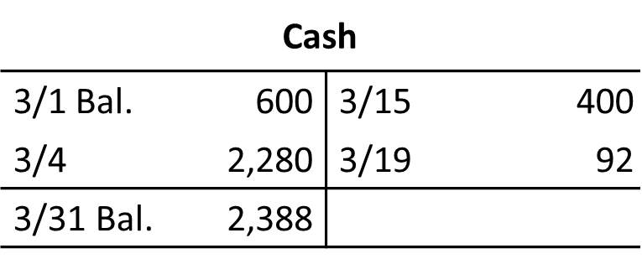
Do It! 3: Posting
Post these entries to the Cash account. The beginning balance of cash on March 1 was $600.
Mar. 4
Cash
2,280
Service Revenue
2,280
15
Salaries and Wages Expense
400
Cash
400
19
Utilities Expense
92
Cash
92
L O 3

Slide 46
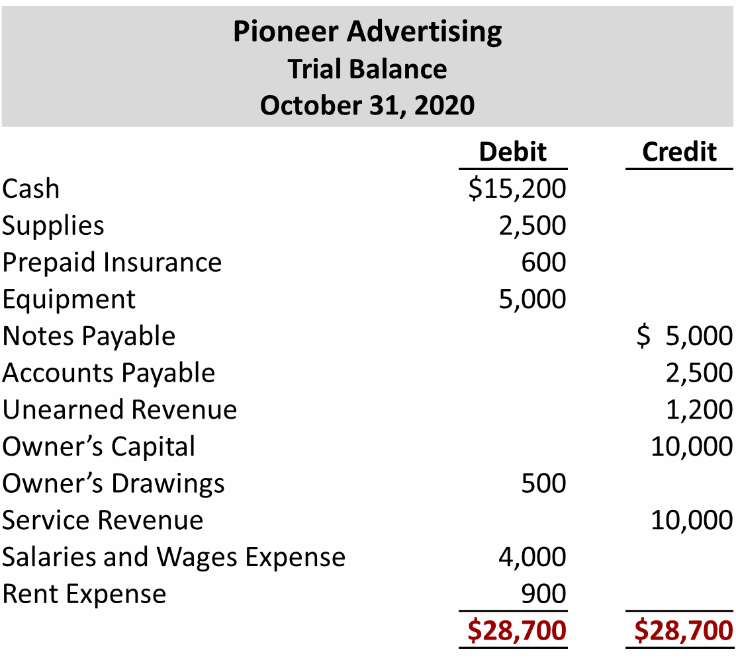
Limitation of a Trial Balance
LEARNING OBJECTIVE 4
Prepare a trial balance.
L O 4

Slide 47
Limitation of a Trial Balance
Trial balance may balance even when:
A transaction is not journalized.
A correct journal entry is not posted.
A journal entry is posted twice.
Incorrect accounts are used in journalizing or posting.
Offsetting errors are made in recording the amount of a transaction.
L O 4

Slide 48
Trial Balance (1 of 4)
Locating Errors
Errors in a trial balance generally result from
mathematical mistakes,
incorrect postings,
or simply transcribing data incorrectly.
L O 4

Slide 49
Trial Balance (2 of 4)
Dollar Signs
Do not appear in journals or ledgers
Typically used only in trial balance and financial statements
Shown only for first item in column and for the total of that column
Underlining
Single line is placed under column of figures to be added or subtracted
Totals are double-underlined
L O 4

Slide 50
Trial Balance (3 of 4)
A trial balance will not balance if:
a. a correct journal entry is posted twice.
b. the purchase of supplies on account is debited to Supplies and credited to Cash.
c. a $100 cash drawing by the owner is debited to Owner’s Drawing for $1,000 and credited to Cash for $100.
d. a $450 payment on account is debited to Accounts Payable for $45 and credited to Cash for $45.
L O 4

Slide 51
Trial Balance (4 of 4)
A trial balance will not balance if:
a. a correct journal entry is posted twice.
b. the purchase of supplies on account is debited to Supplies and credited to Cash.
c. Answer: a $100 cash drawing by the owner is debited to Owner’s Drawing for $1,000 and credited to Cash for $100.
d. a $450 payment on account is debited to Accounts Payable for $45 and credited to Cash for $45.
L O 4

Slide 52
Do It! 4: Posting (1 of 2)
The following accounts come from the ledger of SnowGo Company at December 31, 2020.
157 | Equipment | $88,000 | 301 | Owner’s Capital | $20,000
306 | Owner’s Drawings | 8,000 | 212 | Salaries and Wages Payable | 2,000
201 | Accounts Payable | 22,000 | 200 | Notes Payable (due in 3 months) | 19,000
726 | Salaries and Wages Expense | 42,000 | 732 | Utilities Expense | 3,000
112 | Accounts Receivable | 4,000 | 130 | Prepaid Insurance | 6,000
400 | Service Revenue | 95,000 | 101 | Cash | 7,000
Prepare a trial balance in good form.
L O 4

Slide 53
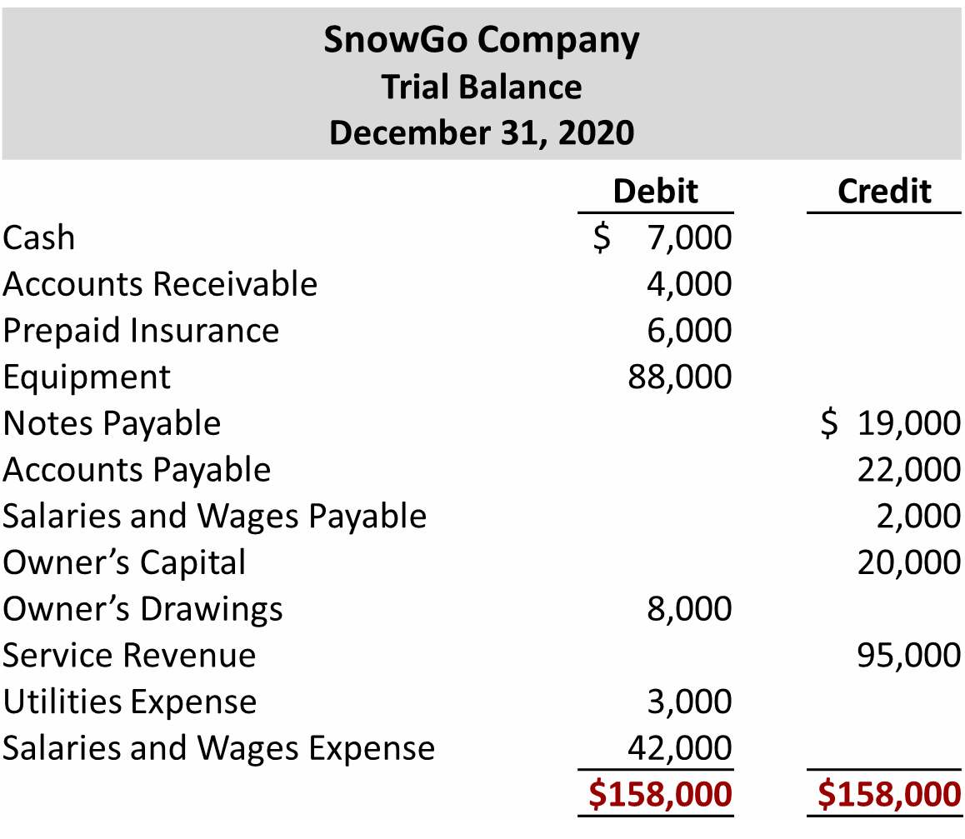
Do It! 4: Posting (2 of 2)
L O 4

Slide 54
A Look at I F R S (1 of 3)
Key Points
Similarities
Transaction analysis is the same under I F R S and G A A P.
Both the I A S B and the F A S B go beyond the basic definitions provided in the textbook for the key elements of financial statements, that is assets, liabilities, equity, revenue, and expenses. The implications of the expanded definitions are discussed in more advanced accounting courses.
As shown in the textbook, dollar signs are typically used only in the trial balance and the financial statements. The same practice is followed under I F R S, using the currency of the country where the reporting company is headquartered.
L O 5

Slide 55
A Look at I F R S (2 of 3)
Key Points
Similarities
A trial balance under I F R S follows the same format as shown in the textbook.
Differences
I F R S relies less on historical cost and more on fair value than do F A S B standards.
Internal controls are a system of checks and balances designed to prevent and detect fraud and errors.
While most public U.S. companies have these systems in place, many non-U.S. companies have never completely documented the controls nor have an independent auditor attest to their effectiveness.
L O 5

Slide 56
A Look at I F R S (3 of 3)
Looking to the Future
The basic recording process shown in this textbook is followed by companies across the globe. It is unlikely to change in the future. The definitional structure of assets, liabilities, equity, revenues, and expenses may change over time as the I A S B and F A S B evaluate their overall conceptual framework for establishing accounting standards.
L O 5

Slide 57
Copyright
Copyright © 2018 John Wiley & Sons, Inc.
All rights reserved. Reproduction or translation of this work beyond that permitted in Section 117 of the 19 76 United States Act without the express written permission of the copyright owner is unlawful. Request for further information should be addressed to the Permissions Department, John Wiley & Sons, Inc. The purchaser may make back-up copies for his/her own use only and not for distribution or resale. The Publisher assumes no responsibility for errors, omissions, or damages, caused by the use of these programs or from the use of the information contained herein.

